Slide 1
Marist College Web technologies MSIS517l Instructor: Michael E. Gildein
Ruby on rails
By
Rahul Challa

Slide 2
Outline – Ruby on Rails
Ruby On Rails Introduction
What is Ruby?
What is Rails?
Strengths of Ruby on Rails
Installing Ruby on Rails Software
Installing Ruby Gems
Installing JetBrains RubyMine
Ruby on Rails Demo
Pros and Cons of Ruby on Rails

Slide 3
Ruby On Rails Introduction
Ruby On Rails (RoR) is a web application framework written in ruby, a dynamically typed programming language.
It is an open-source, full-stack framework for developing database-backed web applications.
→ For Instance, If you want to create or manage web applications that capture and manipulate relational database from a web-based user interface, then Ruby on Rails may be the solution you’ve been looking for to make your web development life easier.

Slide 4
What Is Ruby?
Ruby is a pure object-oriented programming language with a super clean syntax that makes programming elegant and fun.
→ Syntax: puts “My name is Rahul Challa”
In ruby, everything is an object (no primitives).
Ruby is an interpreted scripting language, just like Perl, Python and PHP.

Slide 5
What Is Rails?
Ruby On Rails (RoR) or Just Rails is an open source ruby framework for developing database-backed web applications.
Rails is written in Ruby.
Rails applications are implemented using the Model-View-Controller (MVC)
→ Model – ActiveRecord
→ View – ActionView
→ Controller – ActionController

Slide 6
Strengths of Ruby On Rails
Ruby On Rails cover three test-driven environments.
→ Unit Testing: Testing individual pieces of code
→ Functional Testing: Testing how individual pieces of code interact
→ Integration Testing: Testing the whole system
Ruby On Rails uses database support tools such as Oracle, SQL Server, MySQL, SQLlite

Slide 7
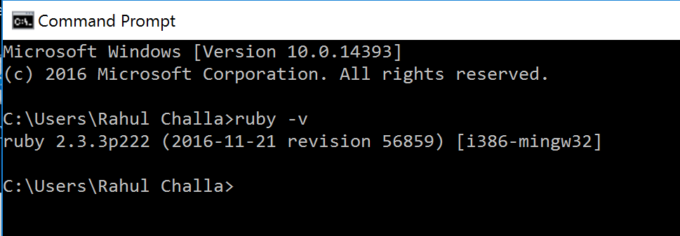
Installing Ruby On Rails Software (1)
Installing Ruby on Rails for windows
Download the ruby installer from
http://rubyinstaller.org/
Click the download option and select the latest version which is Ruby 2.3.3
http://rubyinstaller.org/downloads/
After Ruby installation, open command prompt and type ruby –v to verify installation

Slide 8
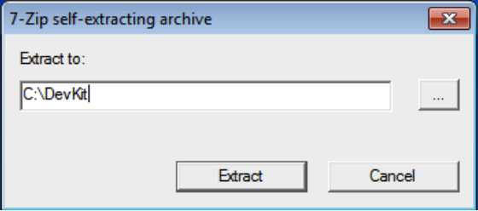
Installing Ruby On Rails Software (2)
Next step is to download and install RubyInstaller Development Kit
http://rubyinstaller.org/add-ons/devkit/
Run the downloaded file it will prompt you for a directory to extract to: simply enter C:\Devkit in the dialog and click ok.
After the extraction completes return to the command prompt we opened earlier and change to the C:\Devkit directory and execute the following two commands to install Ruby.
→ ruby dk.rb init
→ ruby dk.rb install

Slide 9
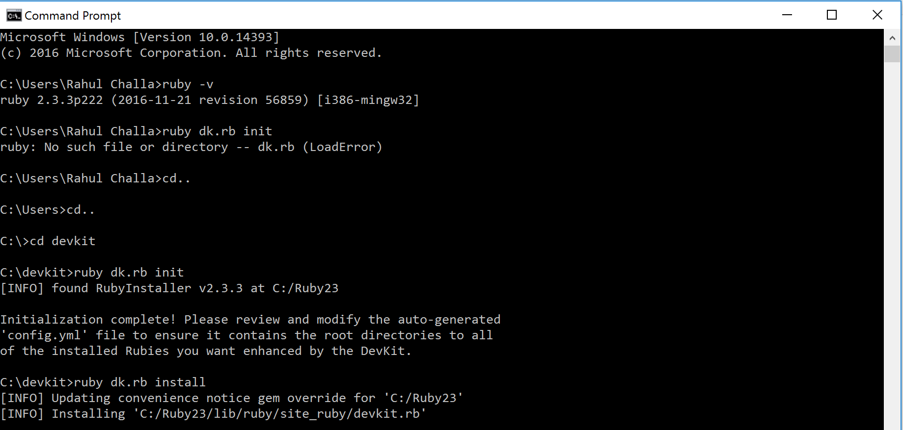
Installing Ruby On Rails Software (3)
Installing Ruby on Rails for Mac
It’s already there!!
Ruby On Rails development environment
Windows, Linux and OS X
No IDE needed although there a few available like eclipse, radrails etc.,
Notes:
IDE – Integrated Development Environment

Slide 10
Installing Ruby Gems (1)
Ruby Gems is a package manager that provides a standard format for distributing ruby programs and libraries.
Can be installed in all operating systems except Linux. The user should place sudo at the front of the preceding line.
Enter the following code to install ruby gems in command prompt or terminal.
→ gem install rake bundler yard watir-webdriver

Slide 11
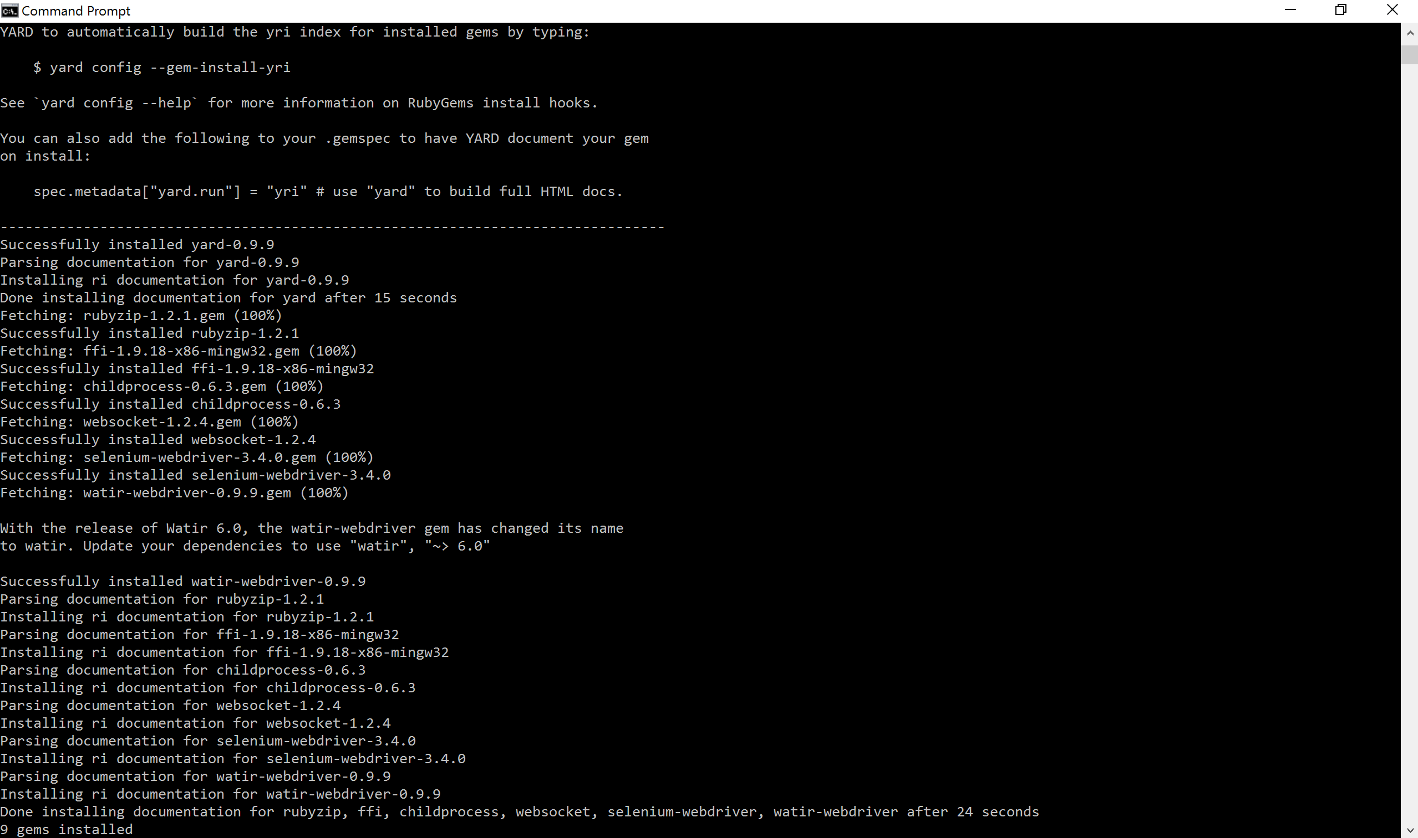
Installing Ruby Gems (2)

Slide 12
Installing JetBrains RubyMine (1)
Goto JetBrains RubyMine webpage to download rubymine editor
https://www.jetbrains.com/ruby/
Next Step, Click download option and select operating system to download the RubyMine.
https://www.jetbrains.com/ruby/download/#section=windows
Follow the steps to install and run the RubyMine and these steps are explained from the following pictures.

Slide 13
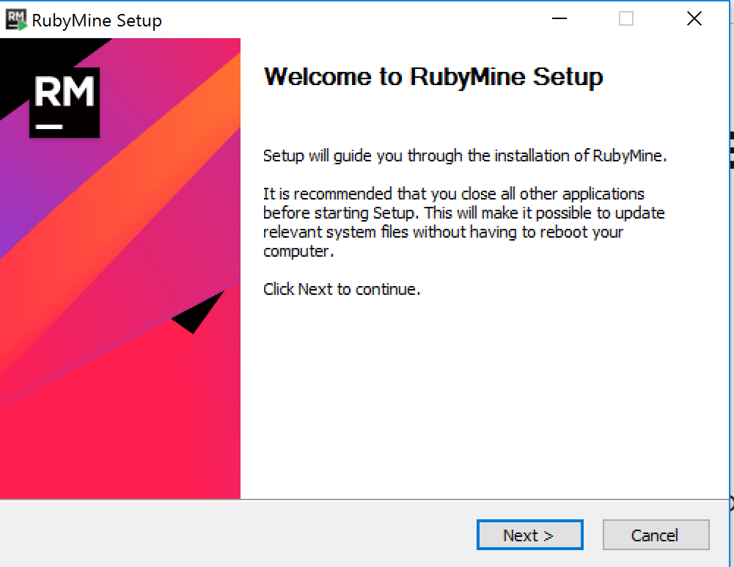
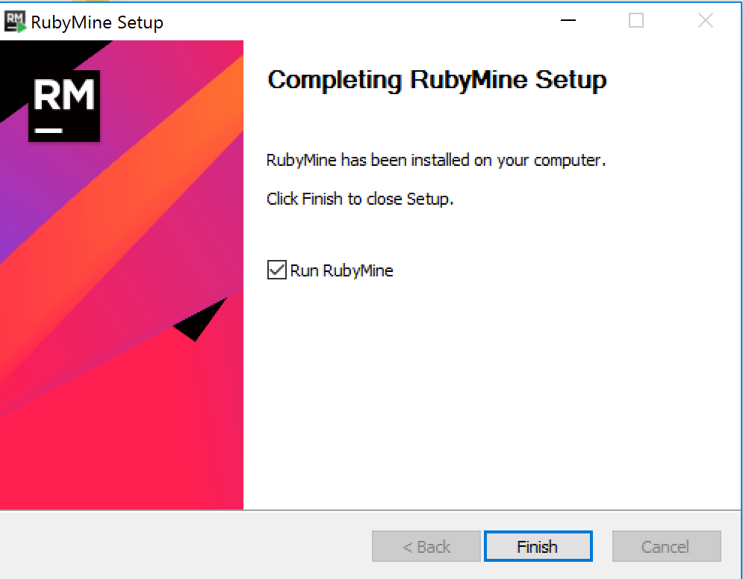
Installing JetBrains RubyMine (2)
Notes:
Step by step procedure to download and install RubyMine

Slide 14
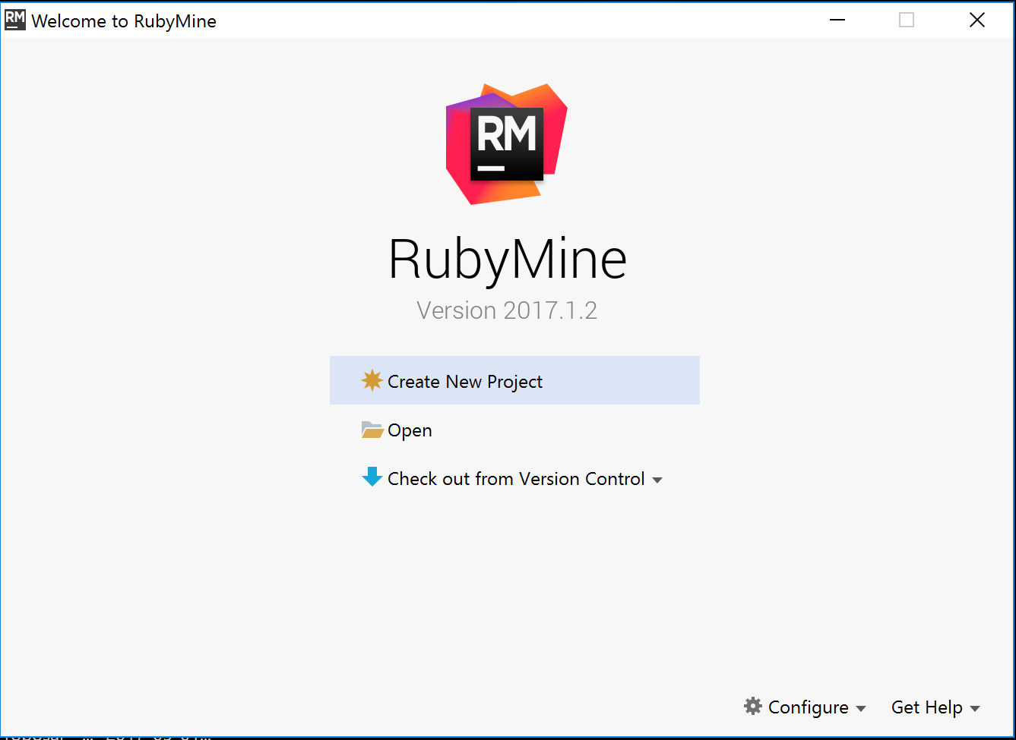
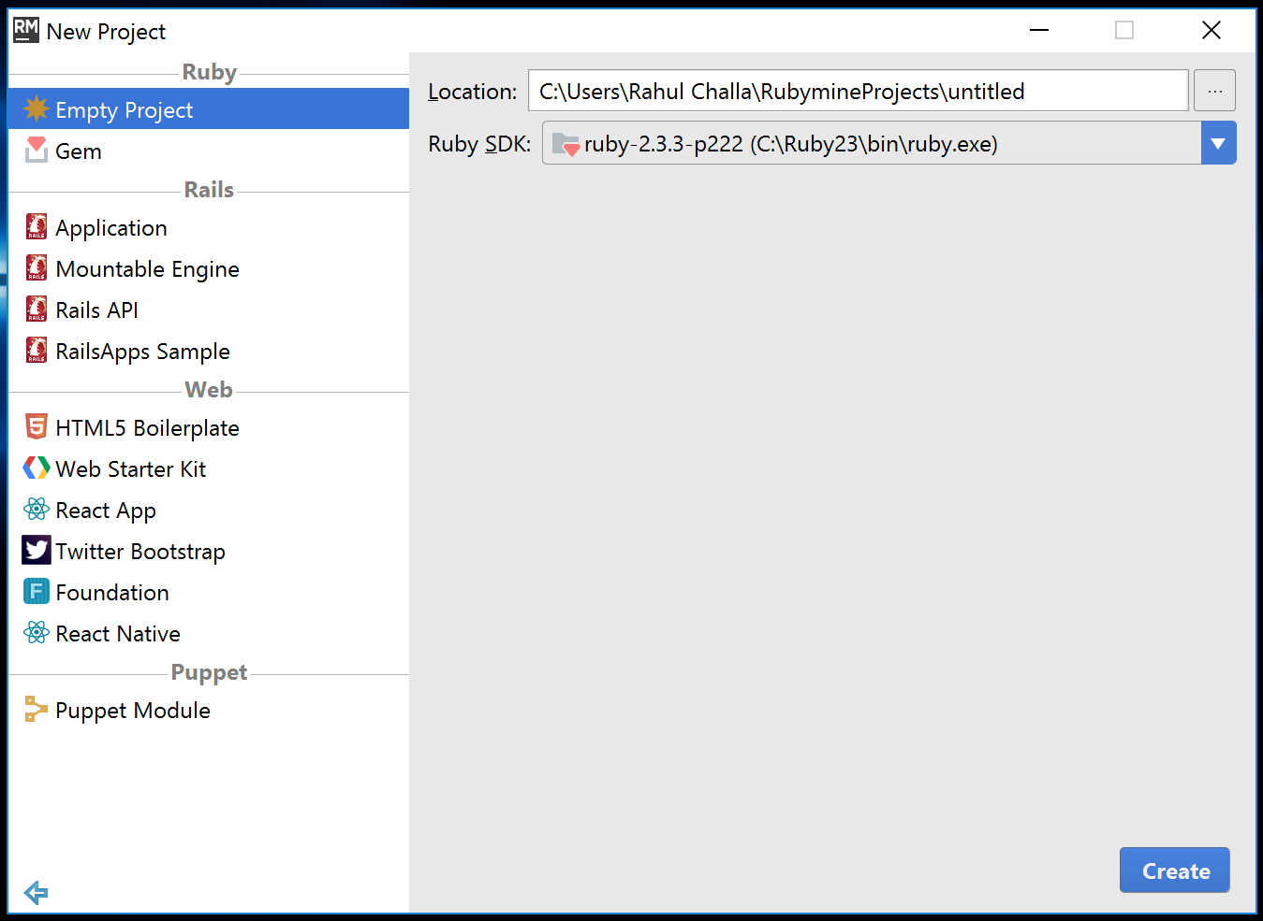
Installing JetBrains RubyMine (3)

Slide 15
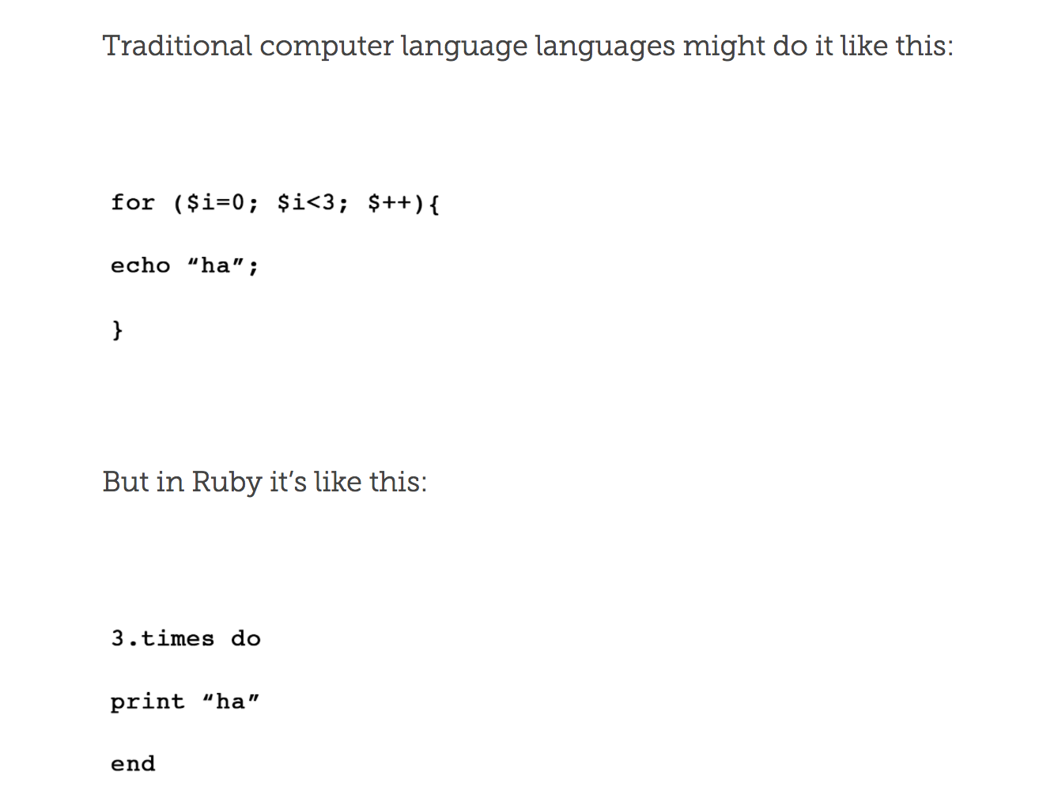
Ruby On Rails Demo (1)
Ruby on Rails programming language is easy to read just like English.
Simple codes has been explained from following pictures.

Slide 16
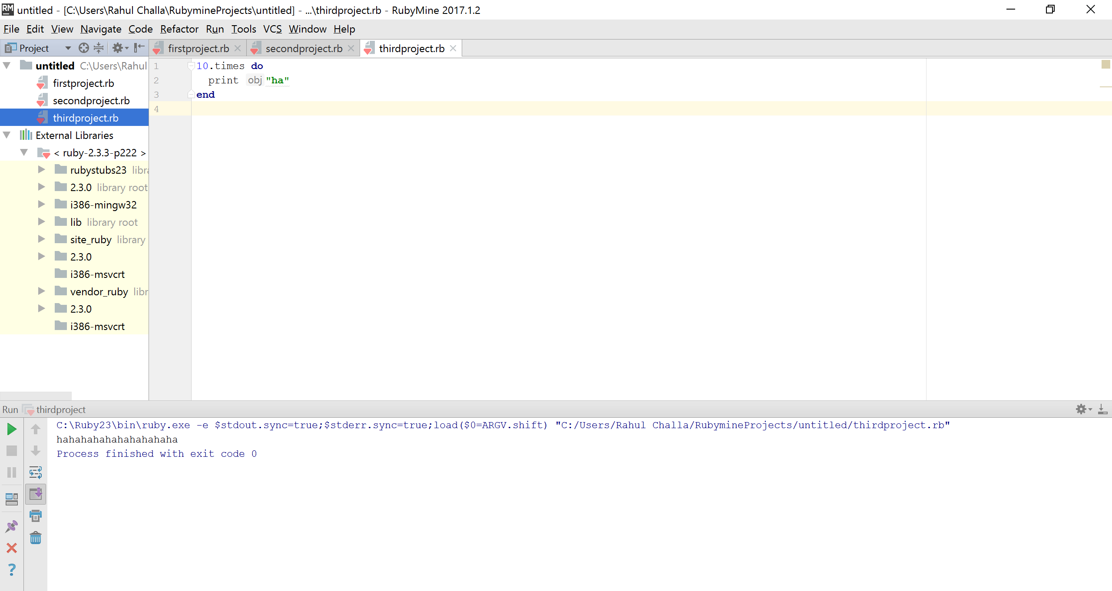
Ruby On Rails Demo (2)

Slide 17
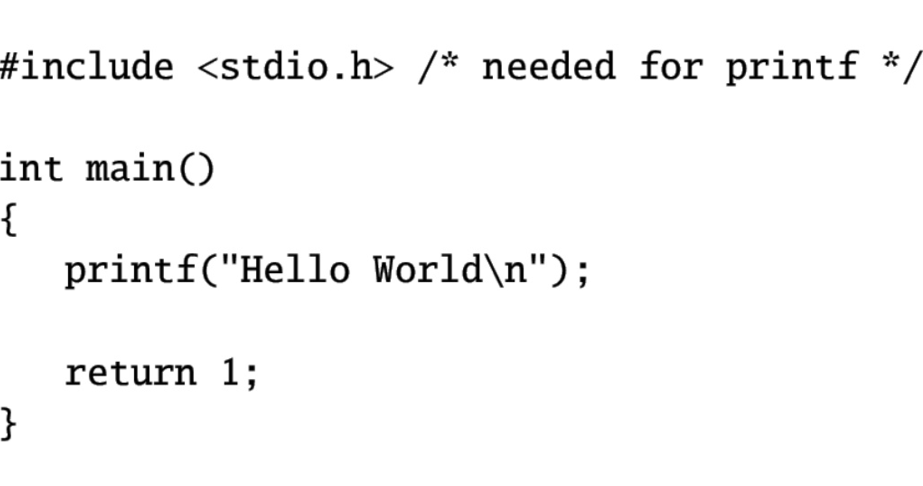
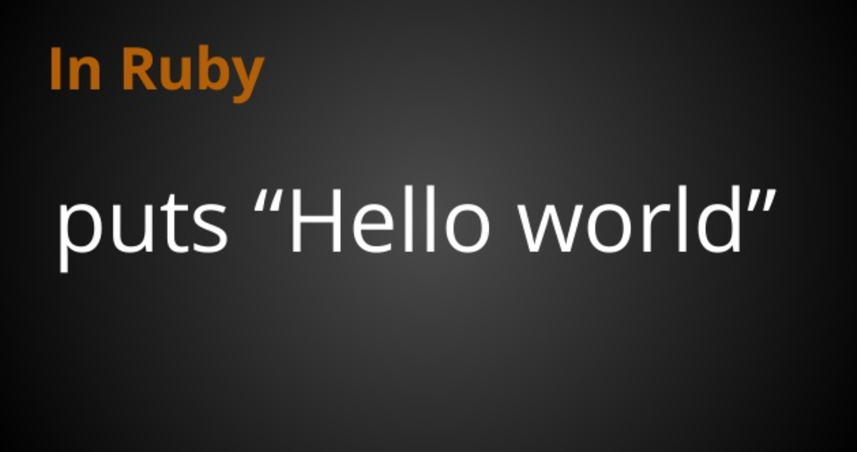
Ruby On Rails Demo (3)

Slide 18
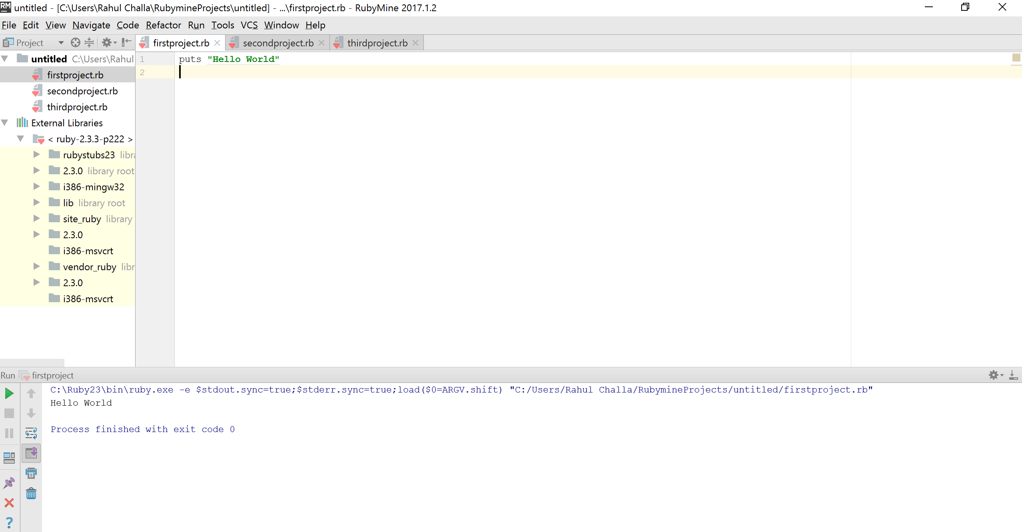
Ruby On Rails Demo (4)

Slide 19
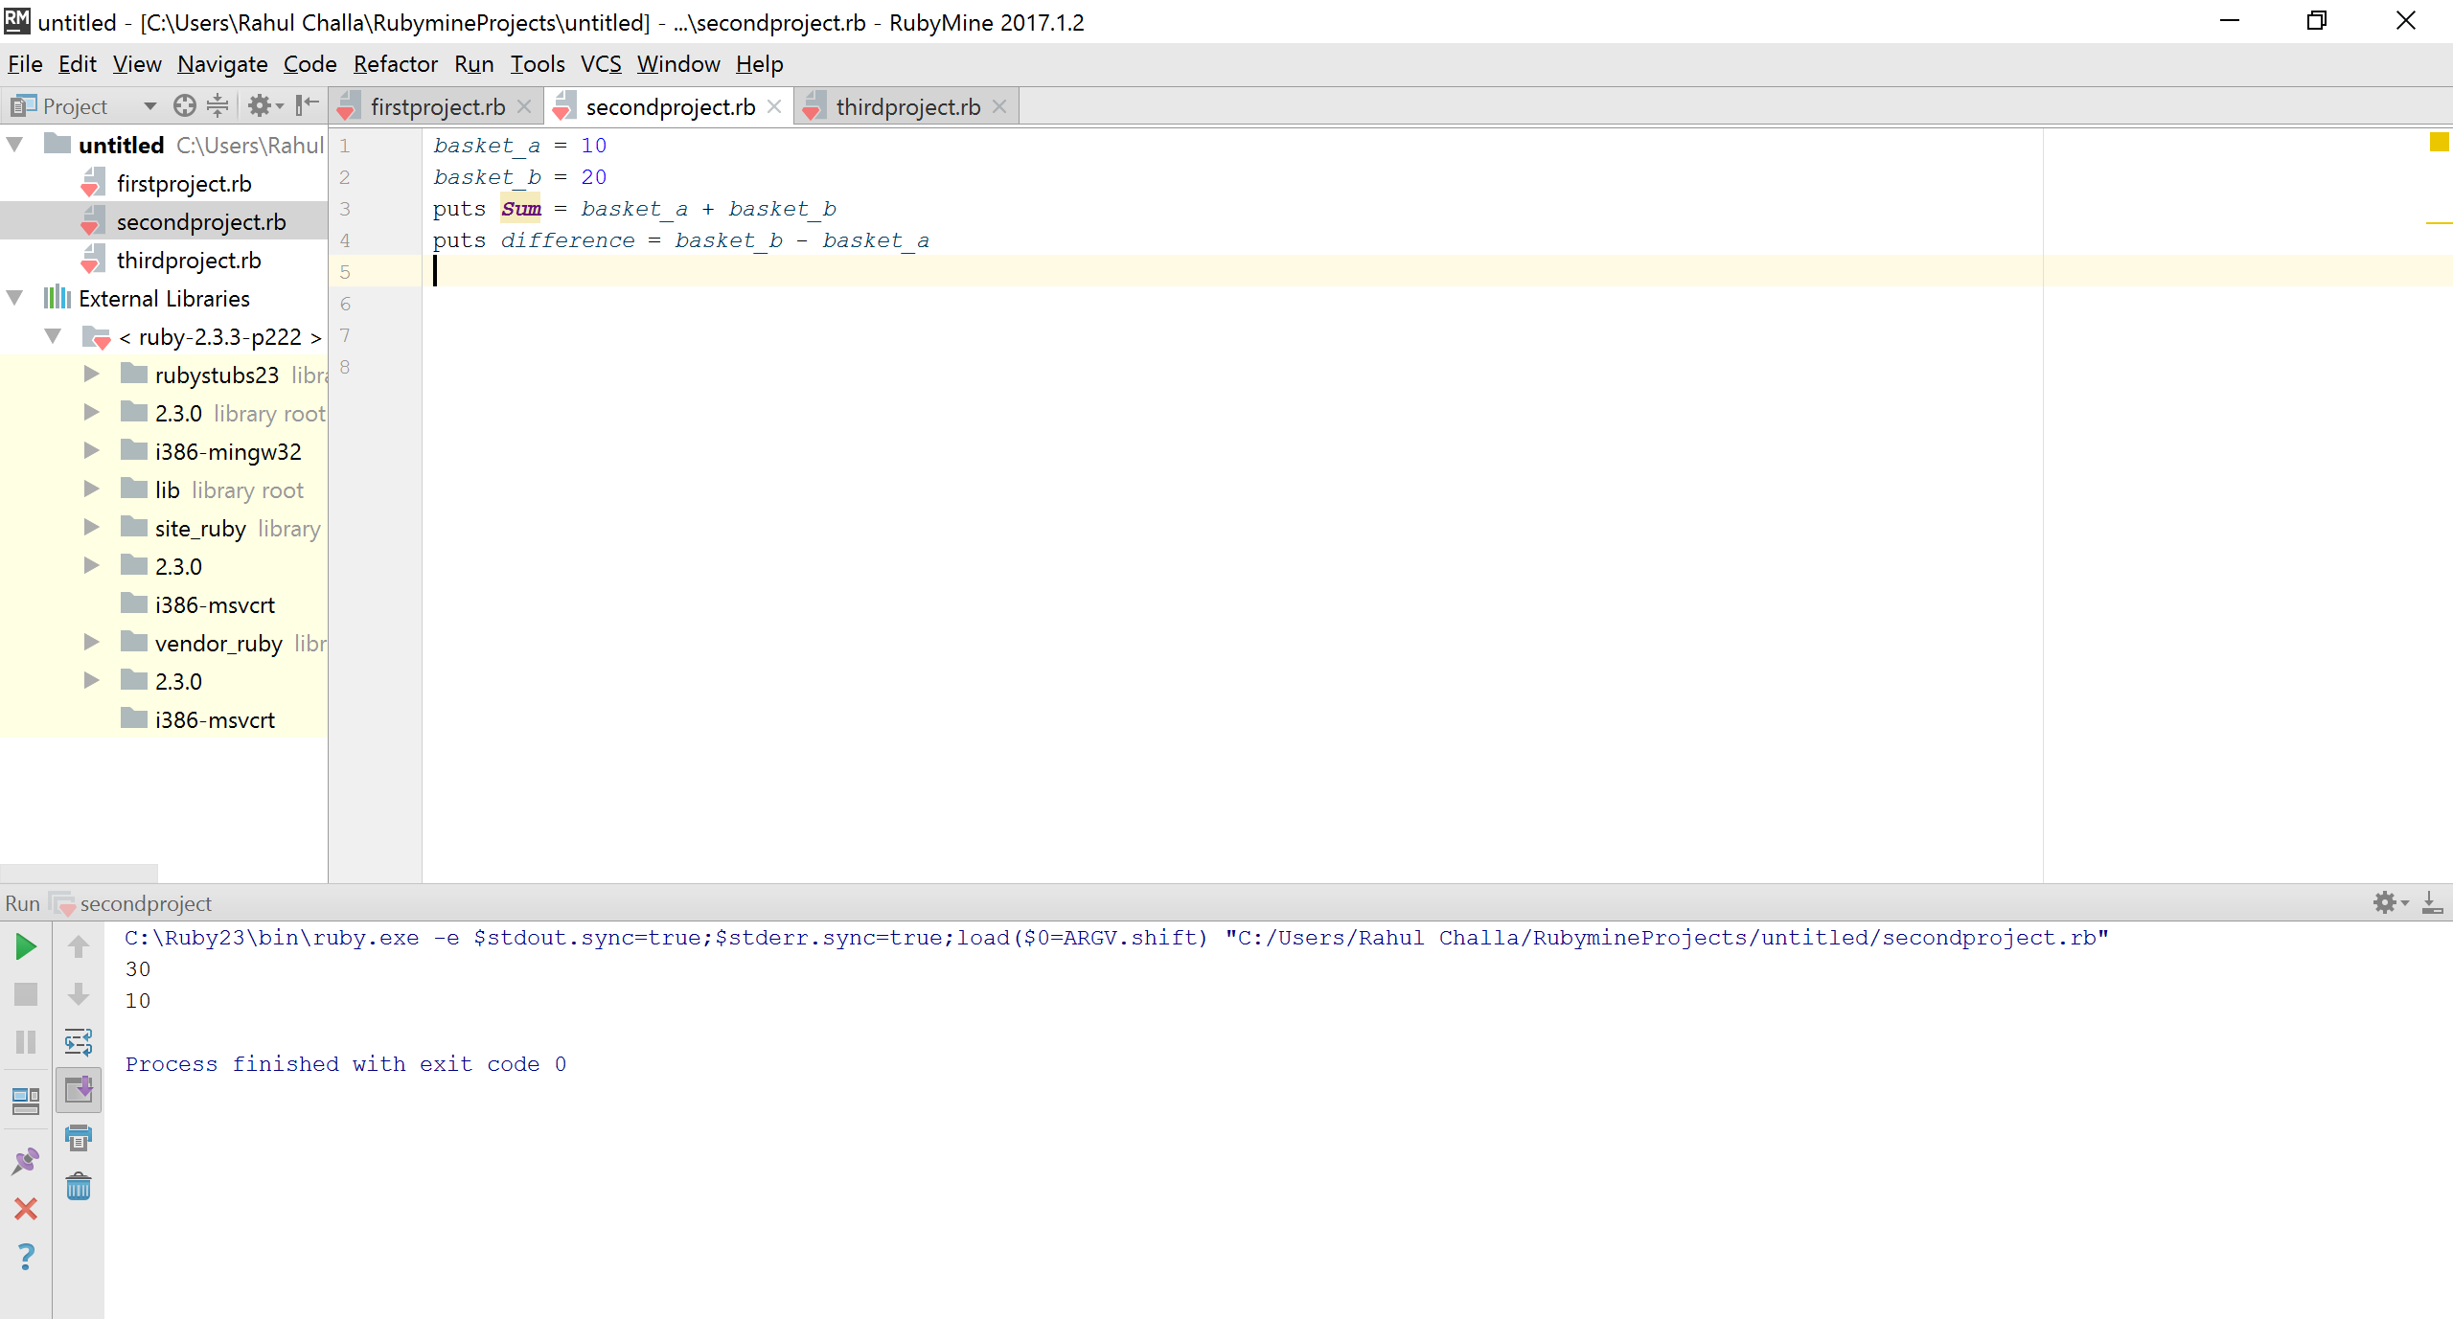
Ruby On Rails Demo (5)

Slide 20
Pros and Cons of Ruby on Rails
Pros:
RoR framework has very simple structure, it’s easy for developers.
Easy to download and install.
Simple programming language like English.
Cons:
The performance is not as fast as on PHP or Javascript.
Scalability issues.
Good quality developers are hard to find.

Slide 21
References:
http://installrails.com/steps/railsinstaller_windows
https://launchschool.com/books/ruby/

Slide 22


